Slide 1

A2A Protocol: Shipping Multi-Agent Apps -
From Silos to Swarms

Slide 2


WHY A2A?

Slide 3
current problems in Agents Integration ?
Scalability Bottlenecks
Lack of Auditability
Poor Collaboration Between Agents
Inconsistent Data Exchange
Tightly Coupled Integrations
Notes:
1. Tightly Coupled Integrations
Every agent needs custom code to talk to other agents.
Leads to fragile, hard-to-maintain spaghetti code and increases technical debt.
2. Inconsistent Data Exchange
No common schema or message structure → agents misinterpret data or fail silently.
Increases chances of bugs, data loss, or misaligned decisions.
3. Poor Collaboration Between Agents
Agents can't delegate tasks or share context effectively.
Results in duplicated work, inefficiencies, and siloed behavior.
4. Scalability Bottlenecks
Without a shared protocol, adding new agents requires rewriting or patching existing ones.
Limits system extensibility and slows down innovation.
5. Lack of Governance and Auditability
No standard for logging interactions or tracing decision chains.
Makes debugging, auditing, or enforcing security policies nearly impossible.

Slide 4
Why A2A
Agents need to talk
Enhanced Collaboration
Future-Proof
Reduced Development Time

Slide 5
What is A2A?
A2A Protocol is an open standard that enables AI agents to communicate and collaborate across different platforms and frameworks.
Maximizes the benefits of agentic AI by enabling true multi-agent scenarios.
Enables agents to work together seamlessly
Supports quick tasks to long-running research

Slide 6

A2A Capabilities
Discovery
Negotiation
Task and State Mgmt
Collaboration

Slide 7
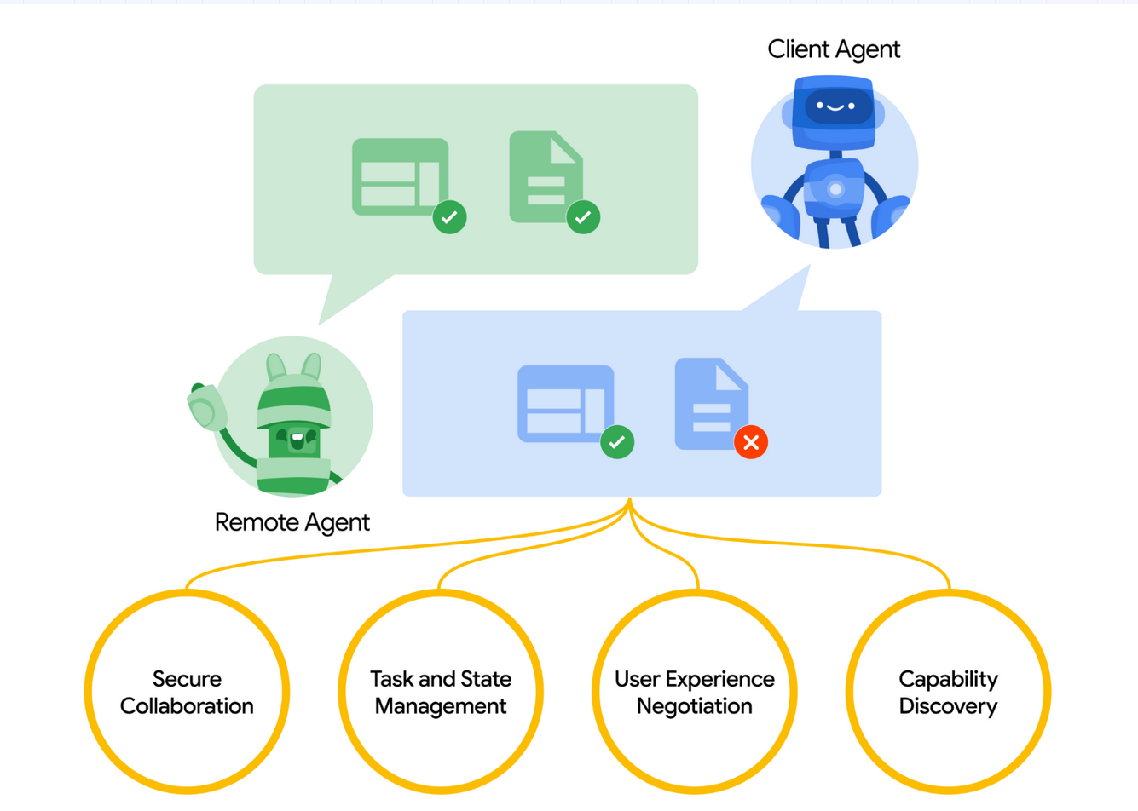
HOW A2A works?

Slide 8
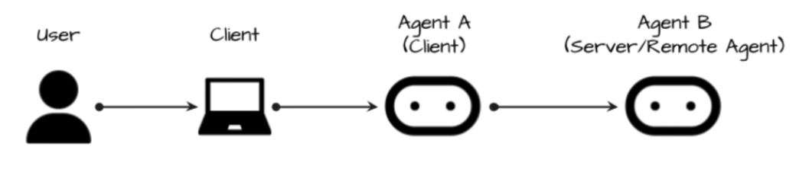
Simple Agent System
Notes:
Ticketing system where travel agent needs to book ticket

Slide 9
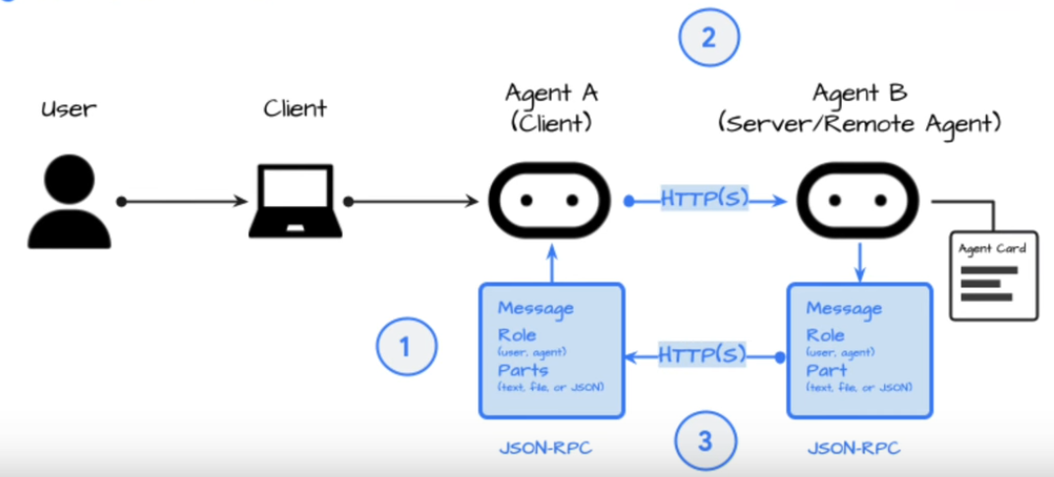
Basic Interaction

Slide 10
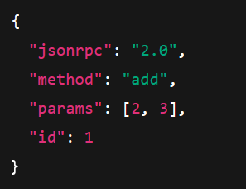
Basic Interaction

Slide 11
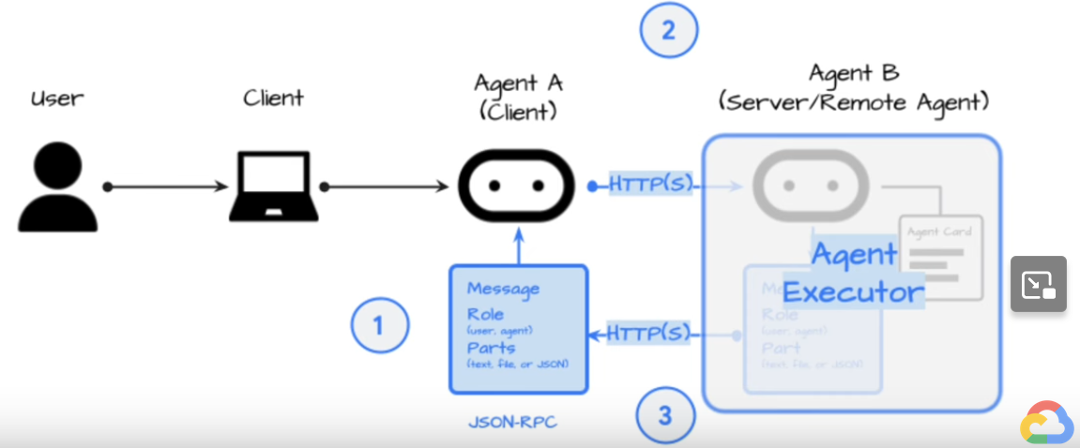
Basic Interaction – Agent executor
Notes:
Custom class we right to handle the pluming , what happens when the agent process its response

Slide 12
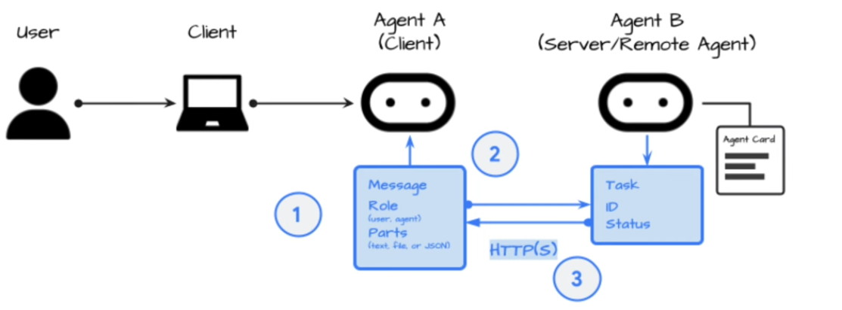
Long Running Agent System

Slide 13
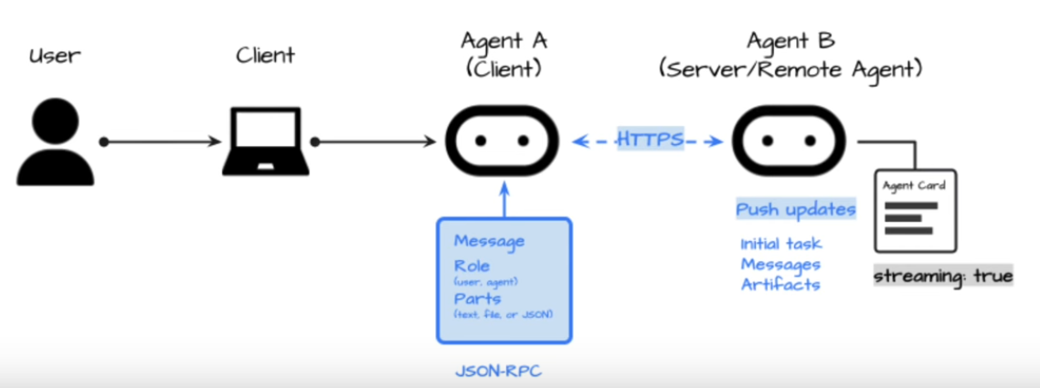
Real Time Agent System - Streaming
Notes:
Polling not always good , so streaming

Slide 14
A2A Vs MCP
A2A | MCP
Protocol for tool access, e.g. Files, DB | Focuses on talking to agents
How Agent uses its Capabilities | How agents collaborate, delegate, and manage shared tasks
Agent MCP to call Weather API | Travel agent asks flight agent to book tickets

Slide 15
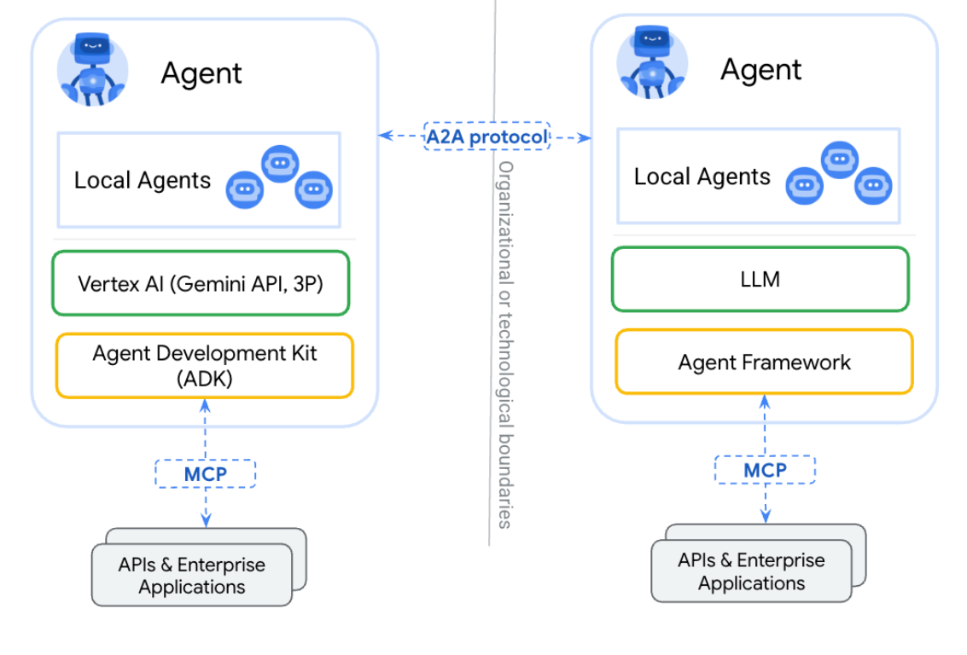
A2A Vs MCP

Slide 16
A2A Vs MCP
Complementary Rather Than Competitive
Notes:
MCP and A2A represent two key dimensions in building AI systems - one oriented toward tool integration, the other toward agent collaboration.

Slide 17

Core components
Client
Server
Event Queue

Slide 18

Communication elements
Agent Card
Task
Message
Part
Artifact
Agent Executor
Notes:
processes requests and generates responses/events is handled by an Agent Executor.

Slide 19
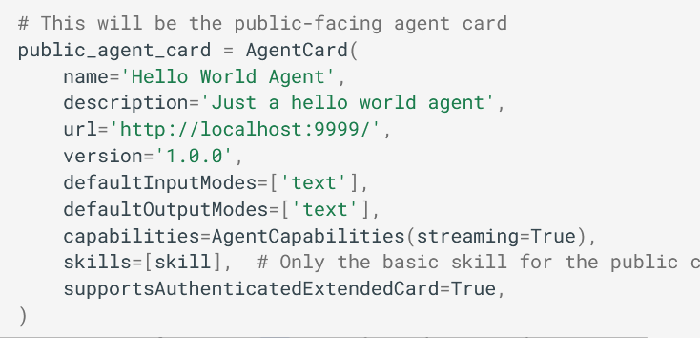
Communication elements – Agent CARD
Agent Card
Task
Message
Part
Artifact
Notes:
A2A Servers MUST make an Agent Card available. The Agent Card is a JSON document that describes the server's identity, capabilities, skills, service endpoint URL, and how clients should authenticate and interact with it.

Slide 20
Communication elements
Agent Card
Task
Message
Part
Artifact
Agent Executor
Notes:
processes requests and generates responses/events is handled by an Agent Executor.

Slide 21
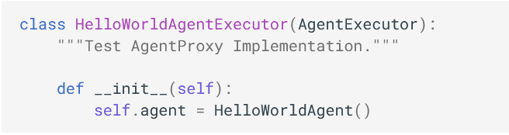
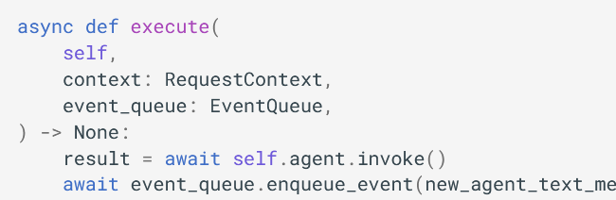
Communication elements – Agent Executor
Agent Card
Task
Message
Part
Artifact
Notes:
processes requests and generates responses/events is handled by an Agent Executor.

Slide 22
Communication elements
Agent Card
Task
Message
Part
Artifact
Agent Executor

Slide 23
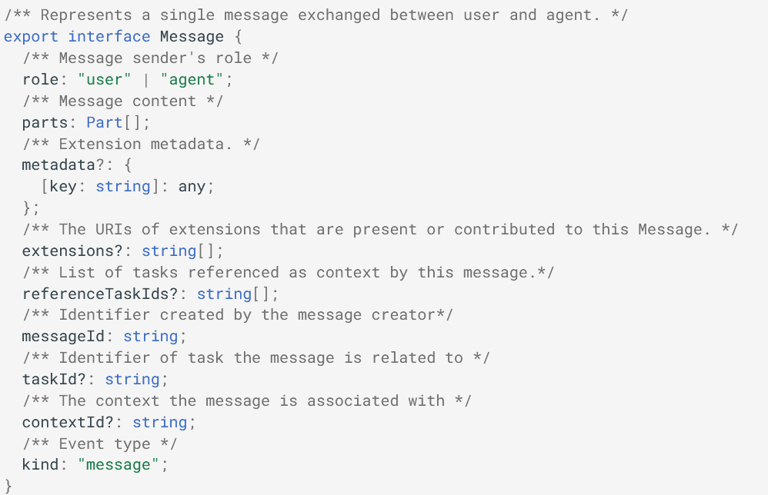
Communication elements - Message
Agent Card
Task
Message
Part
Artifact
Agent Executor
Notes:
Represents a single communication turn or a piece of contextual information between a client and an agent.

Slide 24
Communication elements
Agent Card
Task
Message
Part
Artifact
Agent Executor
Notes:
Represents the stateful unit of work being processed by the A2A Server for an A2A Client. When a client sends a message to an agent, the agent might determine that fulfilling the request requires a stateful task to be completed (e.g., "generate a report," "book a flight," "answer a question").

Slide 25
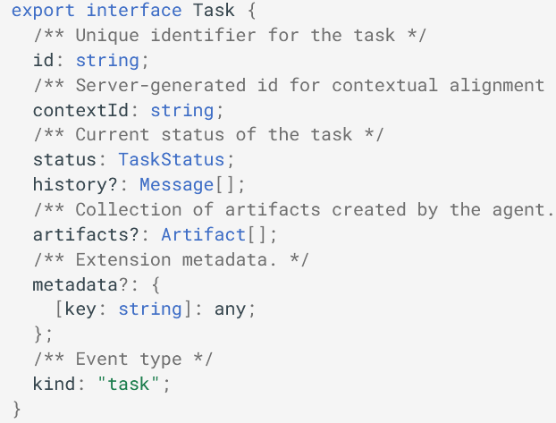
Communication elements - TASk
Agent Card
Task
Message
Part
Artifact
Agent Executor
Notes:
Represents the stateful unit of work being processed by the A2A Server for an A2A Client. When a client sends a message to an agent, the agent might determine that fulfilling the request requires a stateful task to be completed (e.g., "generate a report," "book a flight," "answer a question").

Slide 26

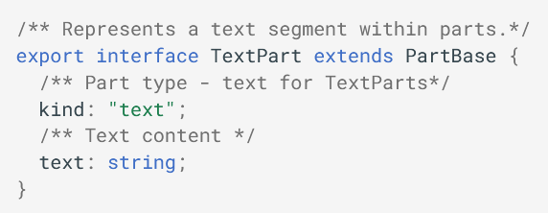
Communication elements - PART
Agent Card
Task
Message
Part
Artifact
Agent Executor
Notes:
Represents a distinct piece of content within a Message or Artifact

Slide 27
Communication elements
Agent Card
Task
Message
Part
Artifact
Agent Executor
Notes:
Represents a tangible output generated by the agent during a task. Artifacts are the results or products of the agent's work.

Slide 28
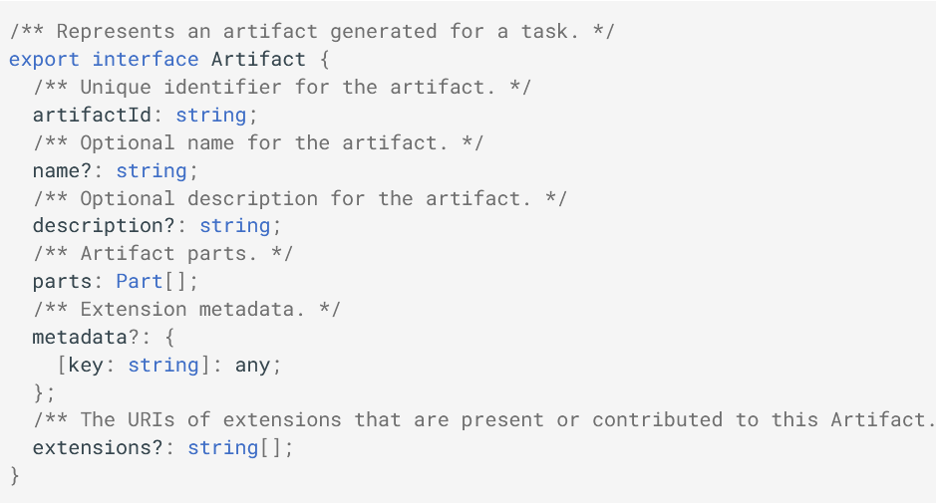
Communication elements - Artifact
Agent Card
Task
Message
Part
Artifact
Agent Executor
Notes:
Represents a tangible output generated by the agent during a task. Artifacts are the results or products of the agent's work.

Slide 29
A2A - Interaction Mechanism
Polling
SSE
Push Notification
Notes:
For tasks that produce results incrementally or provide real-time progress updates. – SSE
For very long-running tasks or scenarios where maintaining a persistent connection (like SSE) is impractical.
he client sends a request (e.g., using the message/send RPC method) and receives a response from the server.- polling

Slide 30
Agent Discovery
Well-Known URI
Catalog-Based Discovery
Private Discovery
Notes:
https://a2aproject.github.io/A2A/latest/topics/agent-discovery/#3-direct-configuration-private-discovery
For AI agents to collaborate using the Agent2Agent (A2A) protocol, they first need to find each other and understand what capabilities the other agents offer.
The Agent Card is a JSON document
https://{agent-server-domain}/.well-known/agent.json
For enterprise environments, marketplaces, or specialized ecosystems, Agent Cards can be published to and discovered via a central registry or catalog.
In many scenarios, especially within tightly coupled systems, for private agents, or during development and testing, clients might be directly configured with Agent Card information or a URL to fetch it.

Slide 31
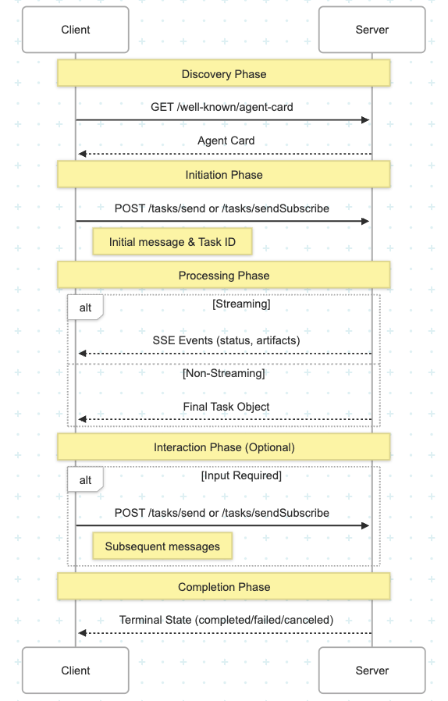
A2A ARCHITECTURE

Slide 32

DEMO

Slide 33

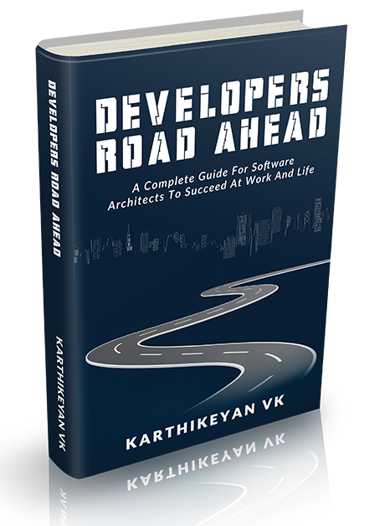
Developers Road Ahead
Complete Guide to Succeed in Software Career

Slide 34

Connect with me
LinkedIn

Slide 35

Thank You!

